Slide 1

VEHICLE DAMAGE ASSESSMENT SYSTEM
Submitted By :
K Chirag Nackathaya 4NM20CS083
Dhanush Poojary 4NM20CS062
Gautham Bhandary 4NM21CS405
Avinash Acharya 4NM21CS403
Under the Guidance of :
Mr. Sunil Kumar Aithal S Assistant Professor Gd II

Slide 2
Abstract
Shared Mobility Challenges
Automated Damage Assessment
Vehicle damages pose increasing liabilities for shared mobility services.
Project focuses on creating an automated system for accurate vehicle damage assessment post-accidents.
System Features
Standardized Approach
Designed to analyze images, identify affected areas, classify damage, estimate repair costs, and generate detailed reports.
Aims to provide a standardized, objective, and efficient solution for vehicle damage assessment.

Slide 3

Problem Statement
Manual Assessment Challenges:
Manual methods cause delays, inconsistencies, and subjective evaluations
Repair cost estimation is time-consuming and lacks standardized data, impacting insurance claims and repairs
Technological Solution Needed:
Advanced AI and computer vision are essential for modern vehicle complexities
We aim to automate damage assessment, ensure fair cost estimation, and boost industry efficiency

Slide 4
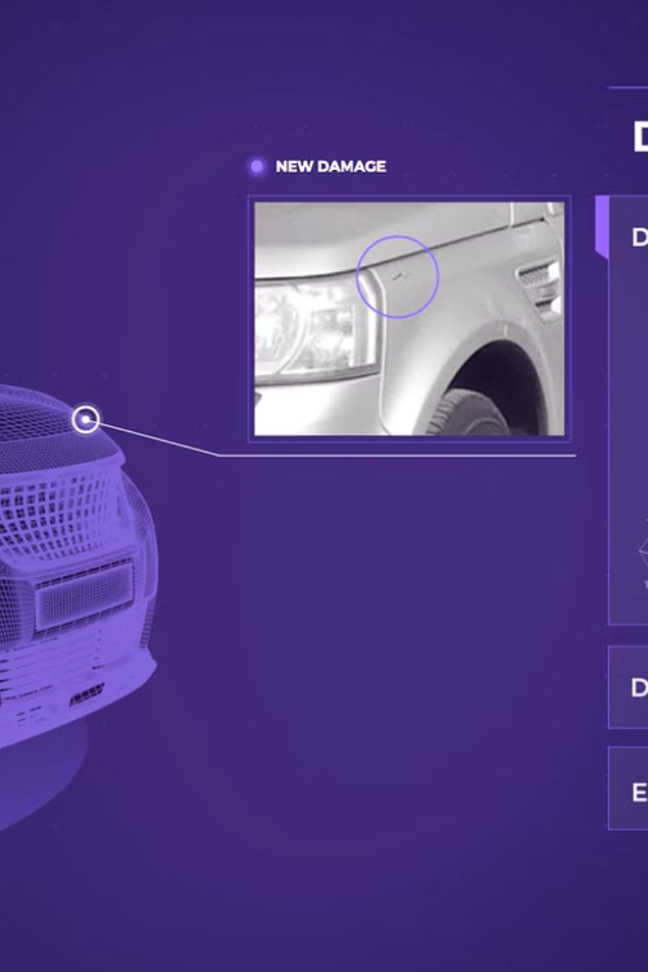
Objective
1
AI-driven Vehicle Damage Identification
2
Data-Driven Repair Cost Estimation
3
User-Friendly Image Upload Interface

Slide 5


Literature Survey
Convolutional Neural Networks for vehicle damage detection by R.E. van Ruitenbeek, S. Bhulai
Automatic damaged vehicle estimator using enhanced deep learning algorithm by Jihad Qaddour , Syeda Ayesha Siddiqa
A Unified Framework of Intelligent Vehicle Damage Assessment based on Computer Vision Technology by Xianglei Zhua, Sen Liub, Peng Zhang

Slide 6
Methodology
1
Collect Pictures
Gather a diverse dataset of images depicting damaged Car to train the YOLOv5 model.
2
Train the model
Develop a program that can classify the damaged image using YoloV5 model.
3
Identify Damage
Create a program that utilizes the trained YOLOv5 model weight to identify and categorize damages within vehicle images.
4
Estimate the price of damage
Using the damage type and it’s severity cost of damage is estimated

Slide 7
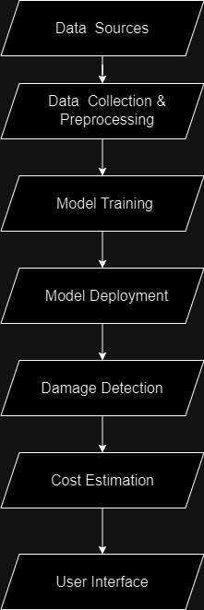
System Design

Slide 8

Conclusion
VDAS Innovation: Using AI, computer vision, and machine learning, VDAS transforms vehicle damage assessments, overcoming traditional inefficiencies for enhanced accuracy and adaptability.
Real-Time Impact: VDAS enables immediate decision-making in crucial situations like insurance claims and resale evaluations, while its versatility integrates seamlessly across insurance and repair.

